Slide 1
INTRODUCTION TO COMPUTING
Course Code: CCINCOM/L
Intro to RL Concepts
Elizer Ponio Jr.
Faculty Member
Department of Computer Science
College of Computing and Information Technologies (CCIT)
National University
Joseph Marvin R. Imperial
REINFORCEMENT LEARNING
NU College of Computing and Information Technologies
Course Code: CCRNFLRL

Slide 2
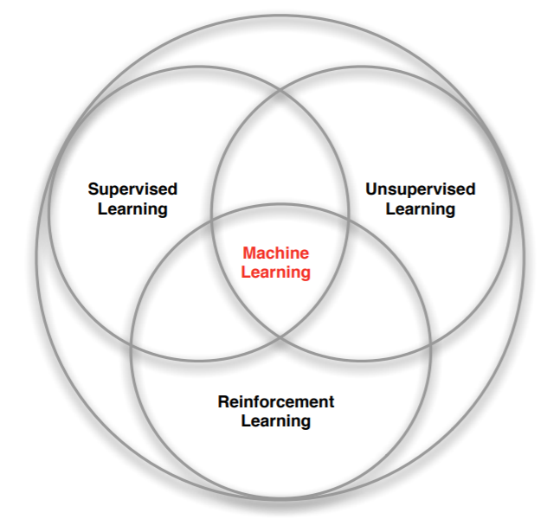
Branches of Machine Learning
INTRODUCTION TO COMPUTING
Course Code: CCINCOM/L
Review in Probability, Intro to RL Concepts
Joseph Marvin R. Imperial
REINFORCEMENT LEARNING
NU College of Computing and Information Technologies
Course Code: CCRNFLRL

Slide 3
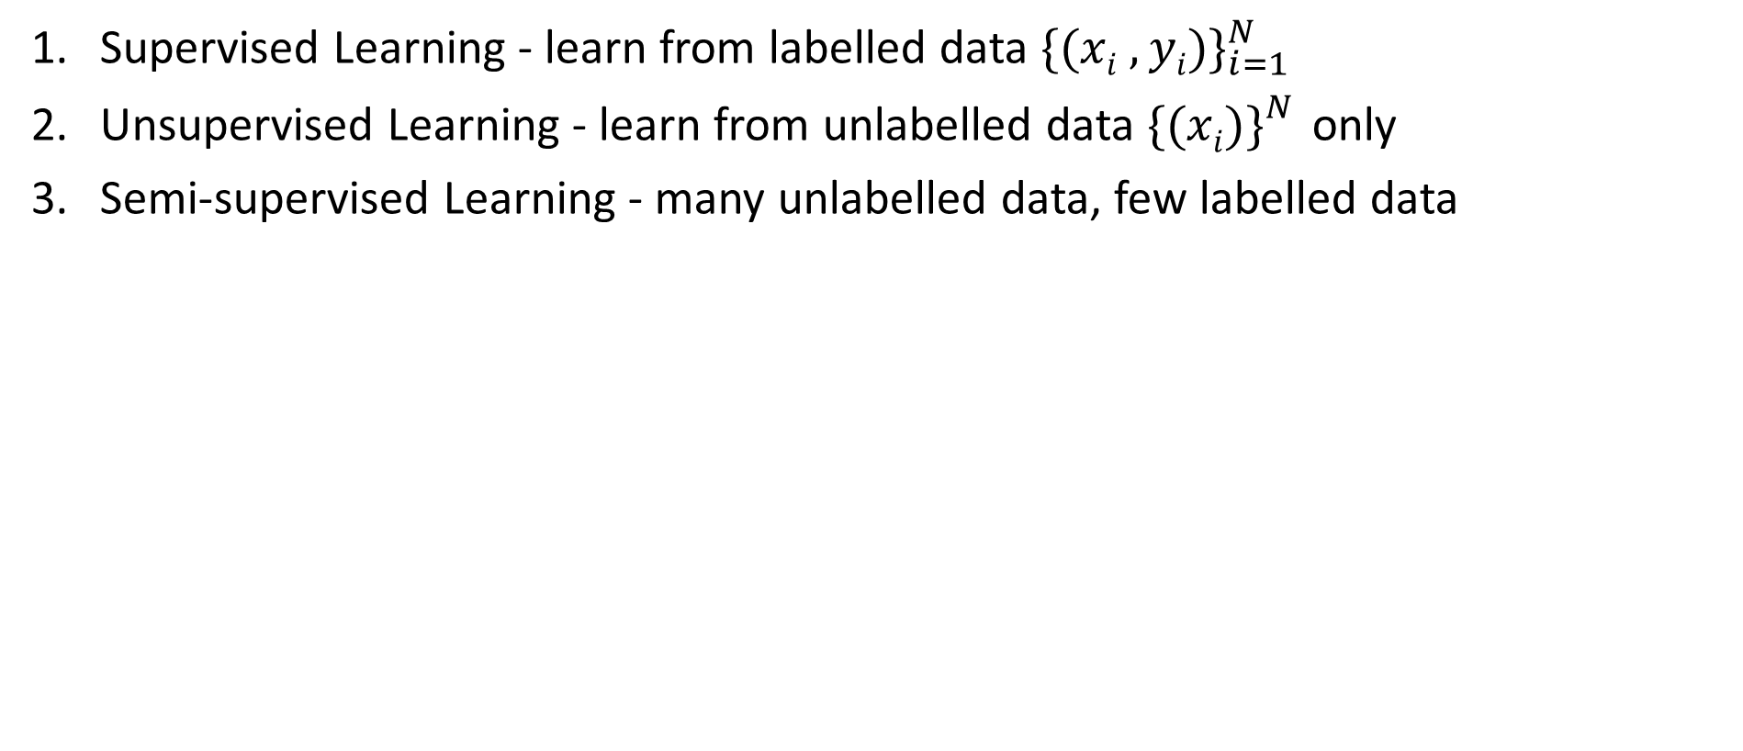
Branches of Machine Learning
INTRODUCTION TO COMPUTING
Course Code: CCINCOM/L
Supervised Learning - learn from labelled data ${\{(xi , yi)\}}_{i=1}^{N}$
Unsupervised Learning - learn from unlabelled data ${\{(xi)\}}_{}^{N}$only
Semi-supervised Learning - many unlabelled data, few labelled data
Review in Probability, Intro to RL Concepts
Joseph Marvin R. Imperial
REINFORCEMENT LEARNING
NU College of Computing and Information Technologies
Course Code: CCRNFLRL

Slide 4
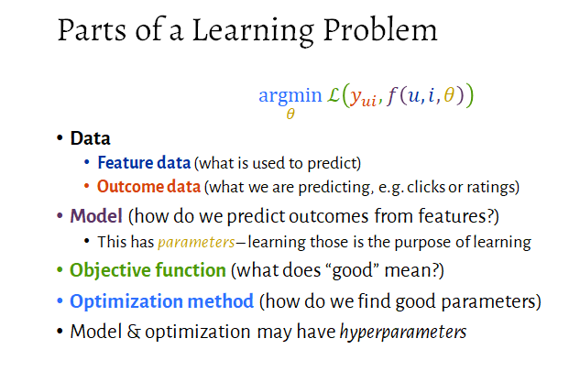
“Learning”
INTRODUCTION TO COMPUTING
Course Code: CCINCOM/L
Review in Probability, Intro to RL Concepts
Joseph Marvin R. Imperial
REINFORCEMENT LEARNING
NU College of Computing and Information Technologies
Course Code: CCRNFLRL

Slide 5
Reinforcement Learning (RL)
INTRODUCTION TO COMPUTING
Course Code: CCINCOM/L
RL is learning from interaction.
There is no supervisor, only signals of reward or evaluative feedback.
Decisions in sequence does matter as they affect the outcome of subsequent decisions.
Review in Probability, Intro to RL Concepts
Joseph Marvin R. Imperial
REINFORCEMENT LEARNING
NU College of Computing and Information Technologies
Course Code: CCRNFLRL

Slide 6
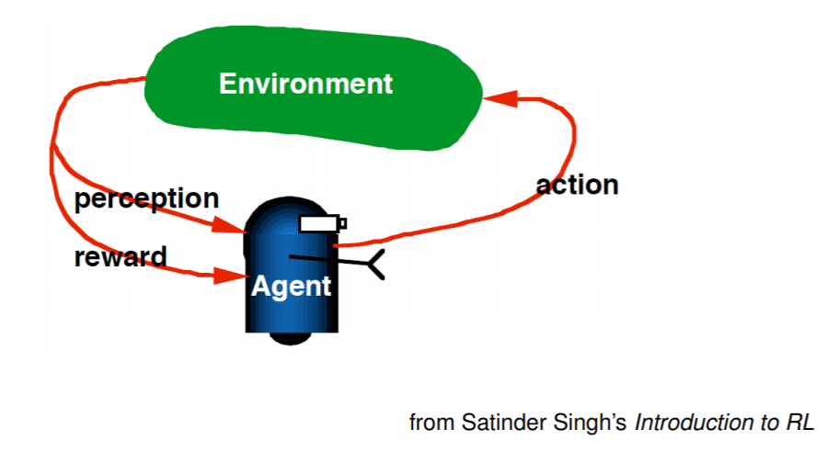

Reinforcement Learning (RL)
INTRODUCTION TO COMPUTING
Course Code: CCINCOM/L
Review in Probability, Intro to RL Concepts
Joseph Marvin R. Imperial
REINFORCEMENT LEARNING
NU College of Computing and Information Technologies
Course Code: CCRNFLRL

Slide 7
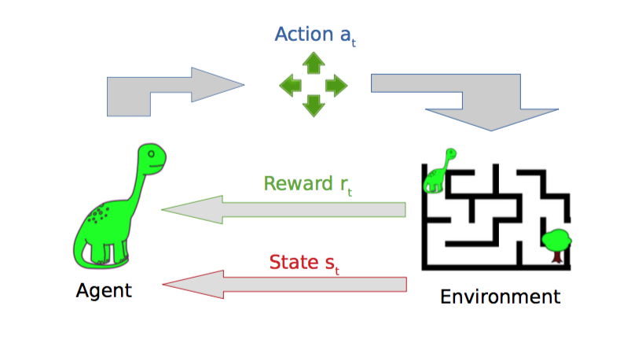
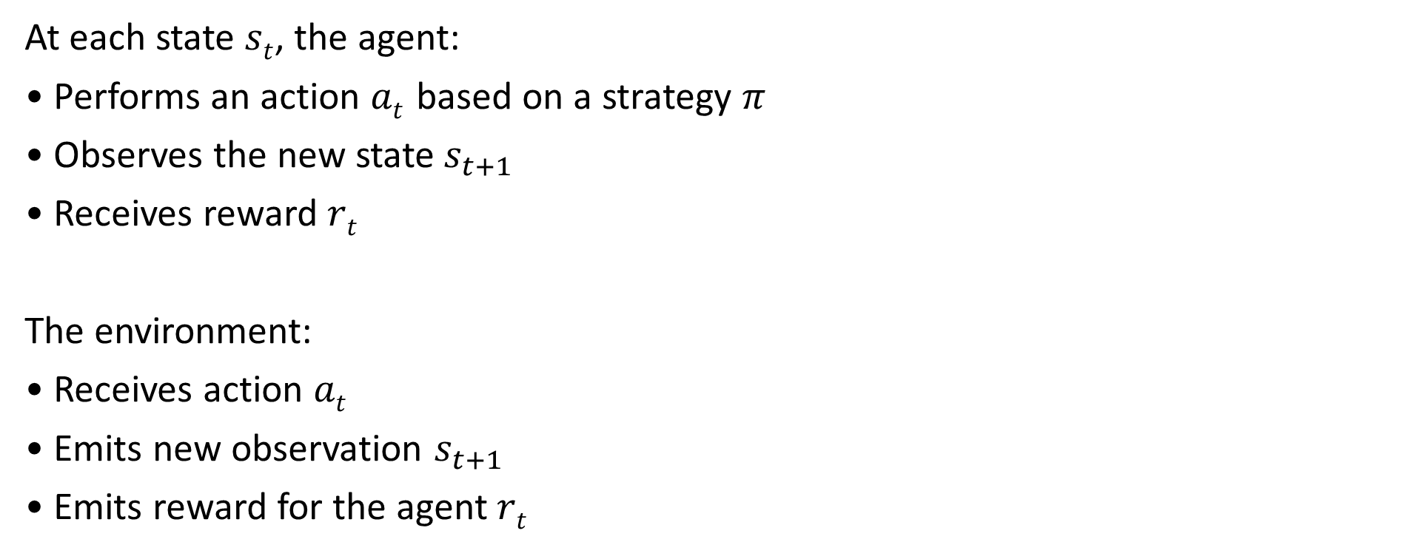
The Agent and the Environment
INTRODUCTION TO COMPUTING
Course Code: CCINCOM/L
At each state $st$, the agent:
• Performs an action $at$ based on a strategy $π$
• Observes the new state${ s}_{t+1}$
• Receives reward $rt$
The environment:
• Receives action $at$
• Emits new observation $s_{t+1}$
• Emits reward for the agent $rt$
Joseph Marvin R. Imperial
REINFORCEMENT LEARNING
NU College of Computing and Information Technologies
Course Code: CCRNFLRL

Slide 8
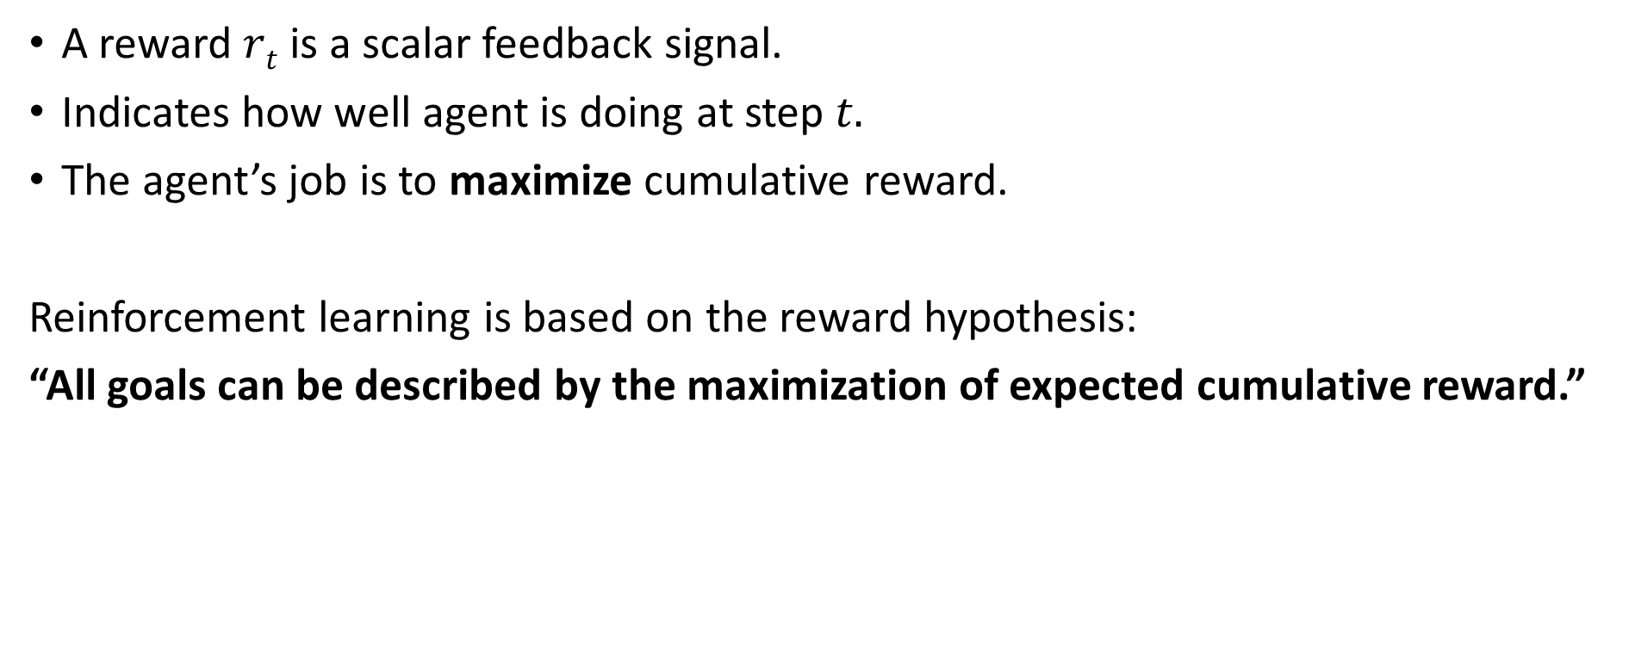
The Reward
INTRODUCTION TO COMPUTING
Course Code: CCINCOM/L
A reward $rt$ is a scalar feedback signal.
Indicates how well agent is doing at step $t.$
The agent’s job is to maximize cumulative reward.
Reinforcement learning is based on the reward hypothesis:
“All goals can be described by the maximization of expected cumulative reward.”
Joseph Marvin R. Imperial
REINFORCEMENT LEARNING
NU College of Computing and Information Technologies
Course Code: CCRNFLRL

Slide 9
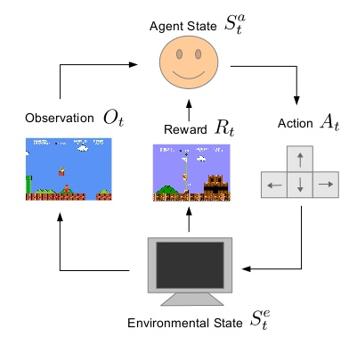
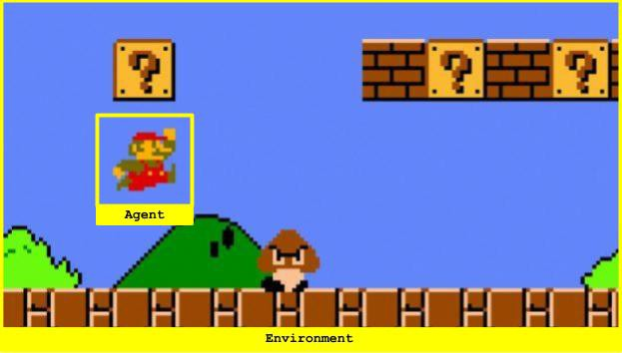
Super Mario
INTRODUCTION TO COMPUTING
Course Code: CCINCOM/L
Review in Probability, Intro to RL Concepts
Joseph Marvin R. Imperial
REINFORCEMENT LEARNING
NU College of Computing and Information Technologies
Course Code: CCRNFLRL

Slide 10
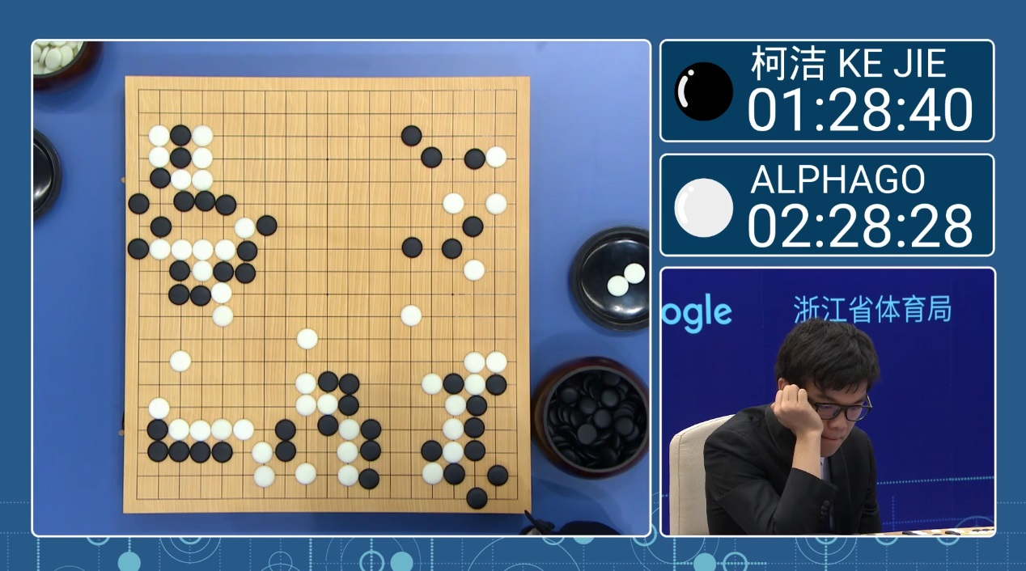


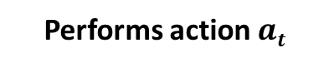
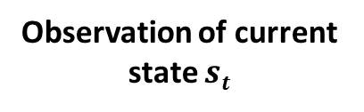
AlphaGo
INTRODUCTION TO COMPUTING
Course Code: CCINCOM/L
Observation of current state $st$
Lee Sedol (Opponent)
Reward is given if game is won.
Performs action $at$
Joseph Marvin R. Imperial
REINFORCEMENT LEARNING
NU College of Computing and Information Technologies
Course Code: CCRNFLRL

Slide 11
Sequential Decision Making
INTRODUCTION TO COMPUTING
Course Code: CCINCOM/L
Goal is to select actions to maximize total future reward.
Actions may have long term consequences.
Reward may be delayed. It may be better to sacrifice immediate reward to gain more long-term reward.
Examples:
A financial investment (may take months to mature)
Refueling a helicopter (might prevent a crash in several hours)
Blocking opponent moves (might help winning chances many moves from now)
In games, taking a risky move only to become useful in the future.
Review in Probability, Intro to RL Concepts
Joseph Marvin R. Imperial
REINFORCEMENT LEARNING
NU College of Computing and Information Technologies
Course Code: CCRNFLRL

Slide 12
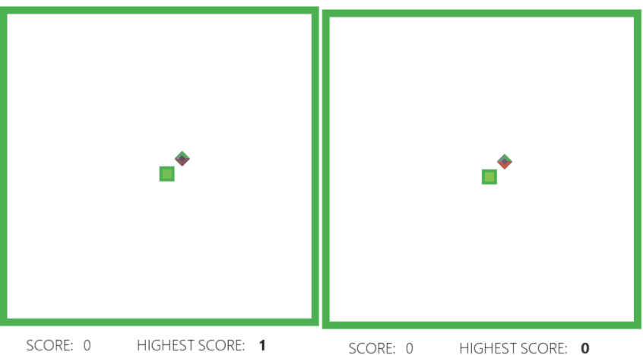
Random Movements vs. Learning
INTRODUCTION TO COMPUTING
Course Code: CCINCOM/L
Review in Probability, Intro to RL Concepts
Joseph Marvin R. Imperial
REINFORCEMENT LEARNING
NU College of Computing and Information Technologies
Course Code: CCRNFLRL

Slide 13
Characteristics of Reinforcement Learning
INTRODUCTION TO COMPUTING
Course Code: CCINCOM/L
What makes reinforcement learning different from other machine learning paradigms?
There is no supervisor, only a reward signal.
Feedback is delayed, not instantaneous.
Time really matters (sequential decision making).
Agent’s actions affect the subsequent data it receives.
Review in Probability, Intro to RL Concepts
Joseph Marvin R. Imperial
REINFORCEMENT LEARNING
NU College of Computing and Information Technologies
Course Code: CCRNFLRL

Slide 14
Success of Reinforcement Learning
INTRODUCTION TO COMPUTING
Course Code: CCINCOM/L
Games
– Backgammon (Tesauro, 1994)
– Solitaire (X. Yan et. al., 2005)
– Chess, Checkers, – deep RL in playing Atari games (2014, Google Deepmind)
Economics
– Trading
Robotics
– Robocup Soccer (e.g. Stone & Veloso, 1999)
– Helicopter Control (e.g. Ng, 2003, Abbeel & Ng, 2006)
– Many Robots (navigation, bi-pedal walking, grasping, switching between skills, ...)
Review in Probability, Intro to RL Concepts
Joseph Marvin R. Imperial
REINFORCEMENT LEARNING
NU College of Computing and Information Technologies
Course Code: CCRNFLRL

Slide 15
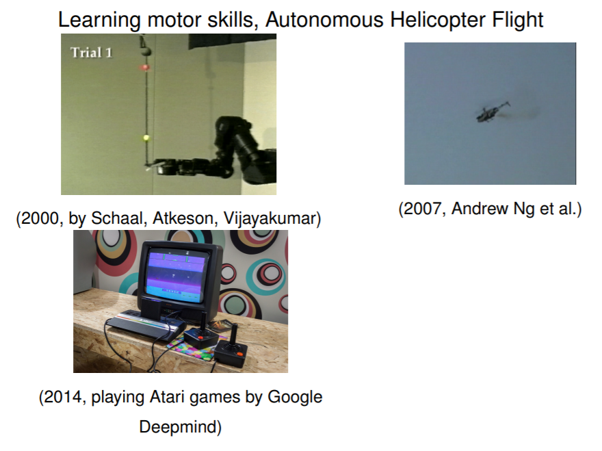
Success of Reinforcement Learning
INTRODUCTION TO COMPUTING
Course Code: CCINCOM/L
Review in Probability, Intro to RL Concepts
Joseph Marvin R. Imperial
REINFORCEMENT LEARNING
NU College of Computing and Information Technologies
Course Code: CCRNFLRL

Slide 16
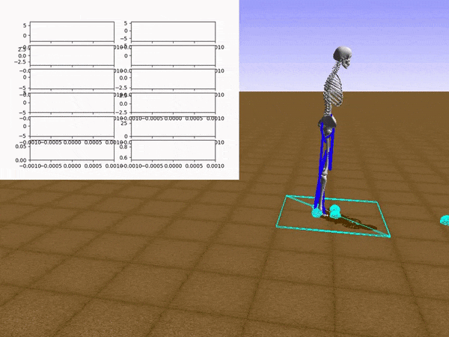
Success of Reinforcement Learning
INTRODUCTION TO COMPUTING
Course Code: CCINCOM/L
Review in Probability, Intro to RL Concepts
Joseph Marvin R. Imperial
REINFORCEMENT LEARNING
NU College of Computing and Information Technologies
Course Code: CCRNFLRL

Slide 17
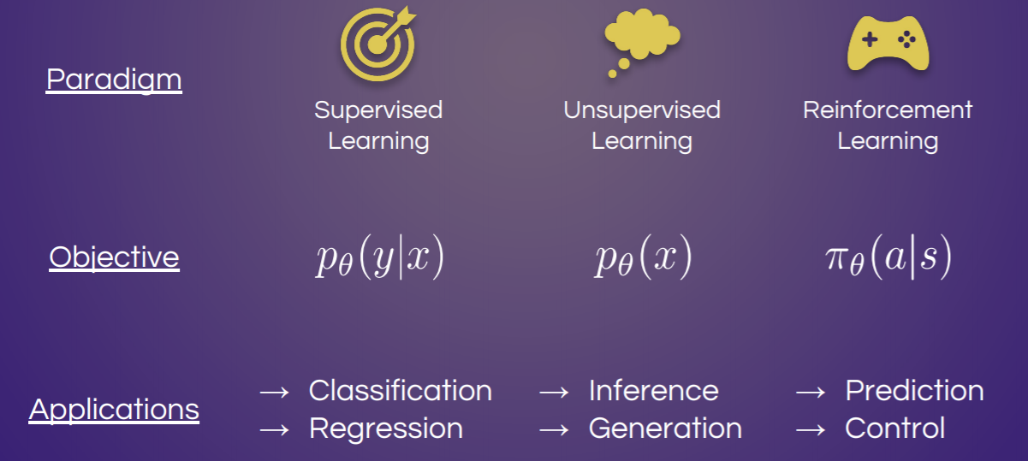
Types of Learning
INTRODUCTION TO COMPUTING
Course Code: CCINCOM/L
Review in Probability, Intro to RL Concepts
Joseph Marvin R. Imperial
REINFORCEMENT LEARNING
NU College of Computing and Information Technologies
Course Code: CCRNFLRL

Slide 18
Major Components of an RL Agent
INTRODUCTION TO COMPUTING
Course Code: CCINCOM/L
How can the RL agent learn?
An RL agent may include one or more of these components:
Policy - agent’s behavior function or strategy .
Value function - how good is each state and/or action .
Model - agent’s representation of the environment. Optional.
Review in Probability, Intro to RL Concepts
Joseph Marvin R. Imperial
REINFORCEMENT LEARNING
NU College of Computing and Information Technologies
Course Code: CCRNFLRL

Slide 19
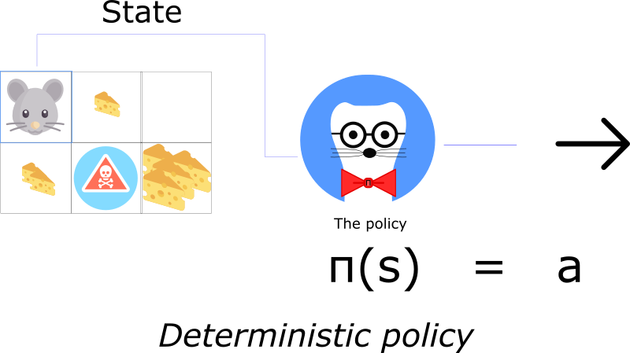
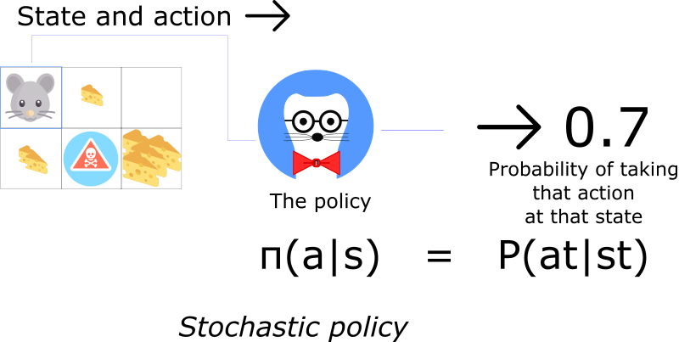
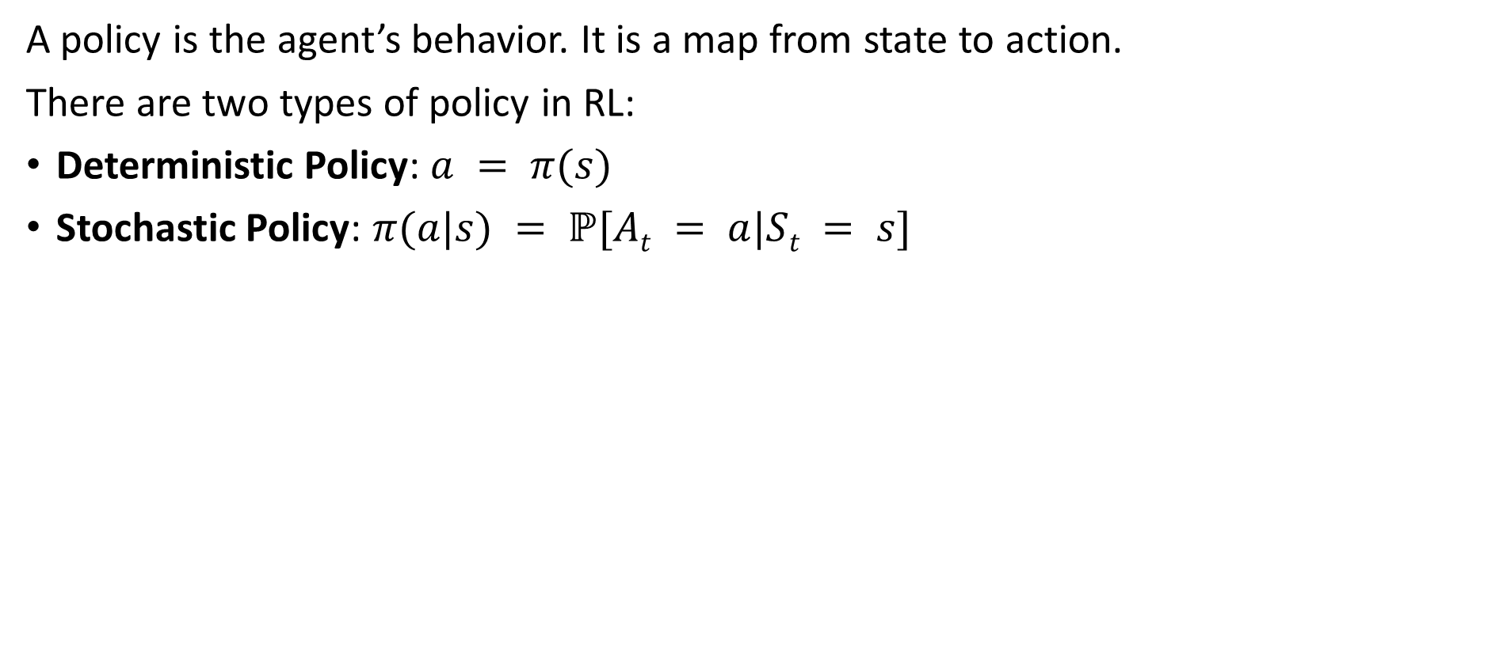

Policy $π$
INTRODUCTION TO COMPUTING
Course Code: CCINCOM/L
A policy is the agent’s behavior. It is a map from state to action.
There are two types of policy in RL:
Deterministic Policy: $a = π(s)$
Stochastic Policy: $π(a|s) = ℙ[At = a|St = s]$
Review in Probability, Intro to RL Concepts
Joseph Marvin R. Imperial
REINFORCEMENT LEARNING
NU College of Computing and Information Technologies
Course Code: CCRNFLRL

Slide 20
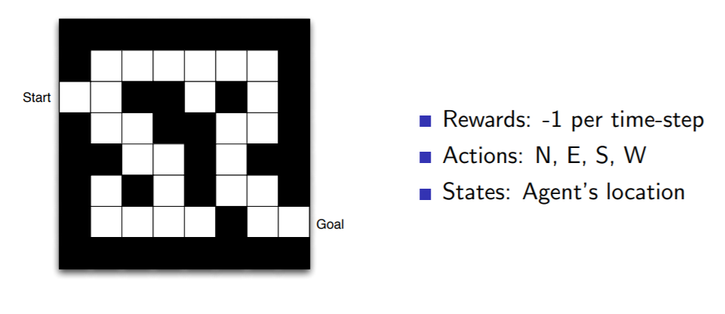
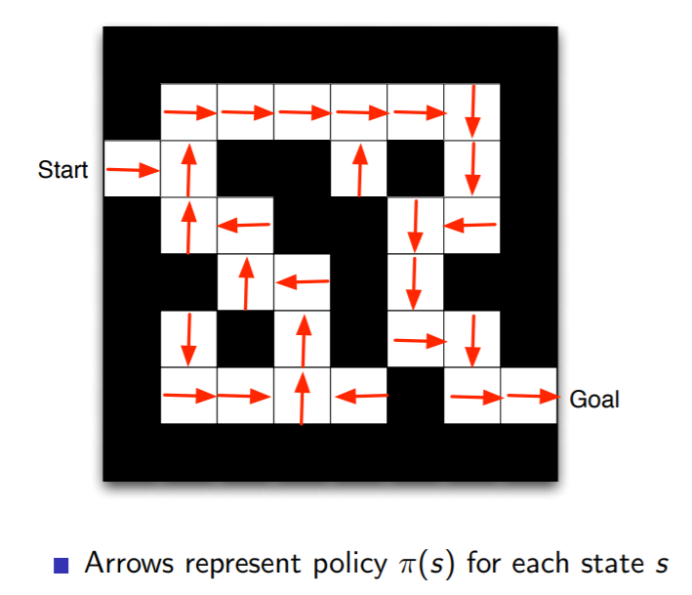
Policy $π$
INTRODUCTION TO COMPUTING
Course Code: CCINCOM/L
Review in Probability, Intro to RL Concepts
Joseph Marvin R. Imperial
REINFORCEMENT LEARNING
NU College of Computing and Information Technologies
Course Code: CCRNFLRL

Slide 21
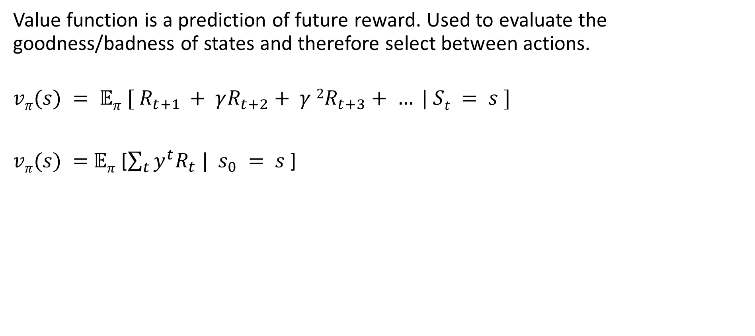
Value Function
INTRODUCTION TO COMPUTING
Course Code: CCINCOM/L
Value function is a prediction of future reward. Used to evaluate the goodness/badness of states and therefore select between actions.
$$vπ(s) = 𝔼π [ R_{t+1} + γR_{t+2}+ γ 2R_{t+3}+ … | St = s ]$$
$vπ(s) =$ $𝔼π$ [$\sum_{t}{y^{t}R_{t} | }$ $s_{0} = s$]
Review in Probability, Intro to RL Concepts
Joseph Marvin R. Imperial
REINFORCEMENT LEARNING
NU College of Computing and Information Technologies
Course Code: CCRNFLRL

Slide 22
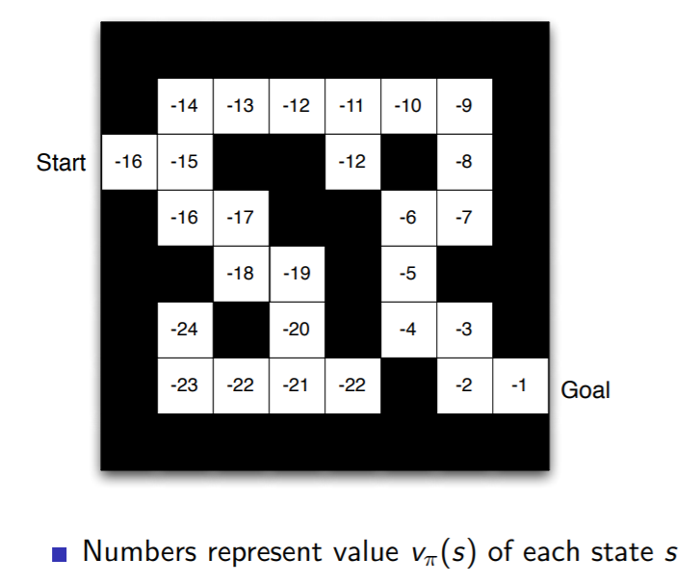
Value Function
INTRODUCTION TO COMPUTING
Course Code: CCINCOM/L
Review in Probability, Intro to RL Concepts
Joseph Marvin R. Imperial
REINFORCEMENT LEARNING
NU College of Computing and Information Technologies
Course Code: CCRNFLRL

Slide 23
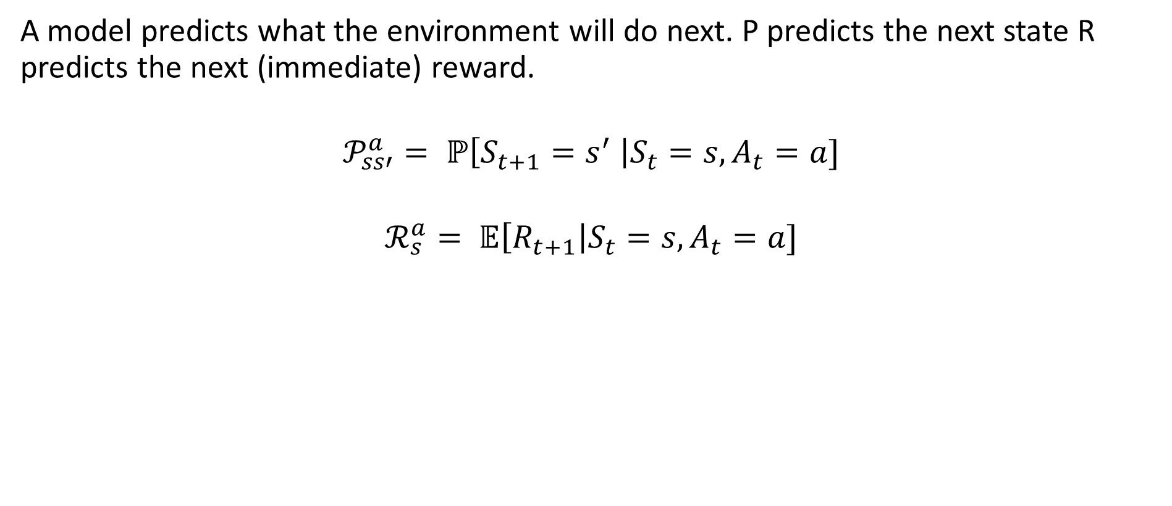
Model
INTRODUCTION TO COMPUTING
Course Code: CCINCOM/L
A model predicts what the environment will do next. P predicts the next state R predicts the next (immediate) reward.
$$𝒫_{ss′}^{a}= ℙ\left[S_{t+1}=s^{′} \right|S_{t}=s, A_{t}=a]$$
$$ℛ_{s}^{a}= 𝔼\left[R_{t+1}\right|S_{t}=s, A_{t}=a]$$
Review in Probability, Intro to RL Concepts
Joseph Marvin R. Imperial
REINFORCEMENT LEARNING
NU College of Computing and Information Technologies
Course Code: CCRNFLRL

Slide 24
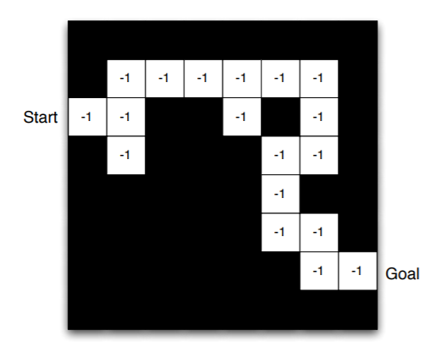
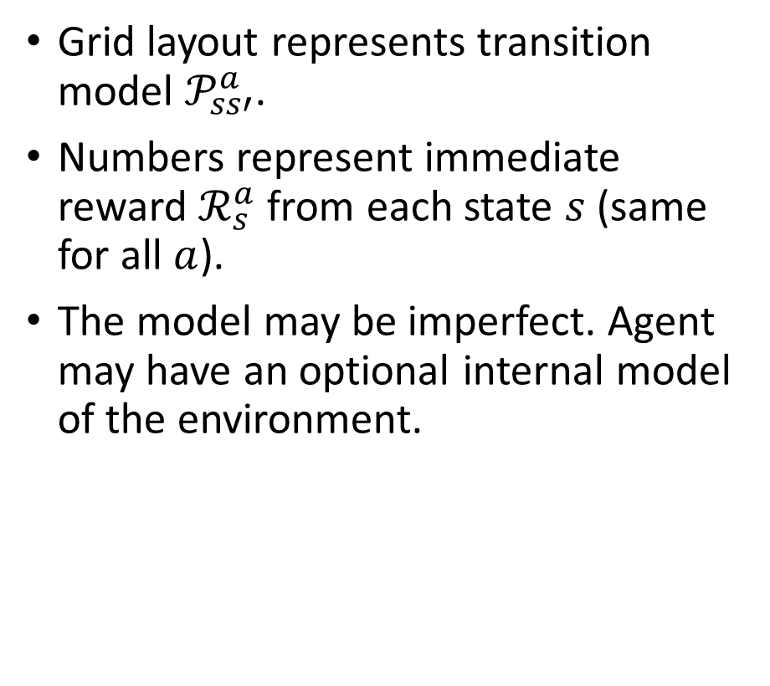
Model
INTRODUCTION TO COMPUTING
Course Code: CCINCOM/L
Grid layout represents transition model $𝒫_{ss′}^{a}$.
Numbers represent immediate reward $ℛ_{s}^{a}$ from each state $s$ (same for all $a$).
The model may be imperfect. Agent may have an optional internal model of the environment.
Review in Probability, Intro to RL Concepts
Joseph Marvin R. Imperial
REINFORCEMENT LEARNING
NU College of Computing and Information Technologies
Course Code: CCRNFLRL

